Slide 1
TABLEAU

Slide 2
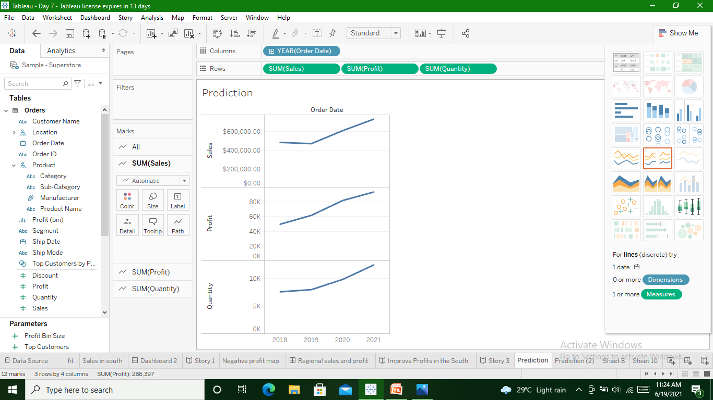
Predict Sales & Profit for year 2022

Slide 3
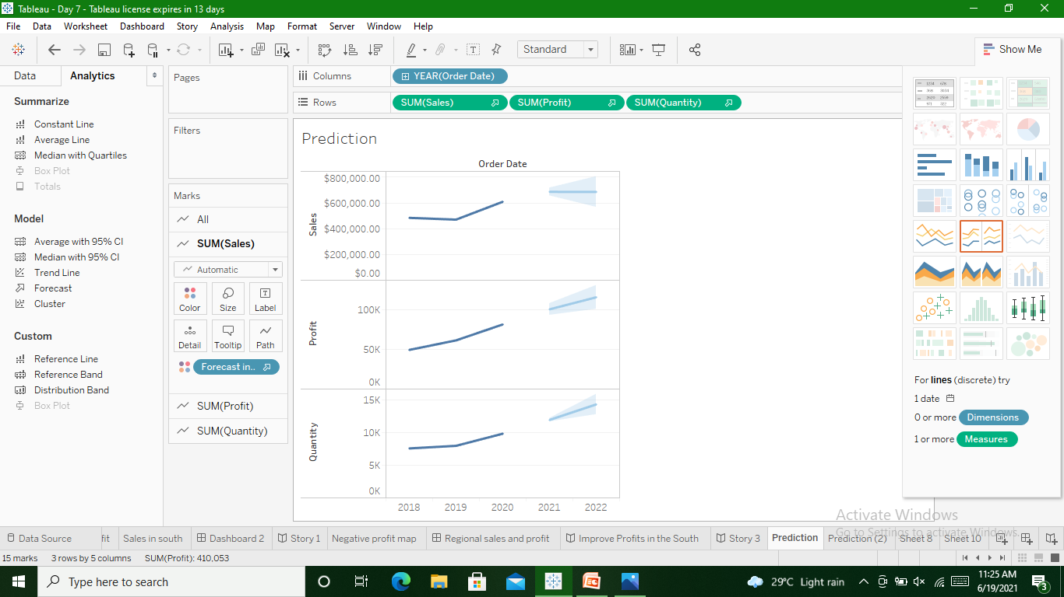
Using forecast option we can predict

Slide 4
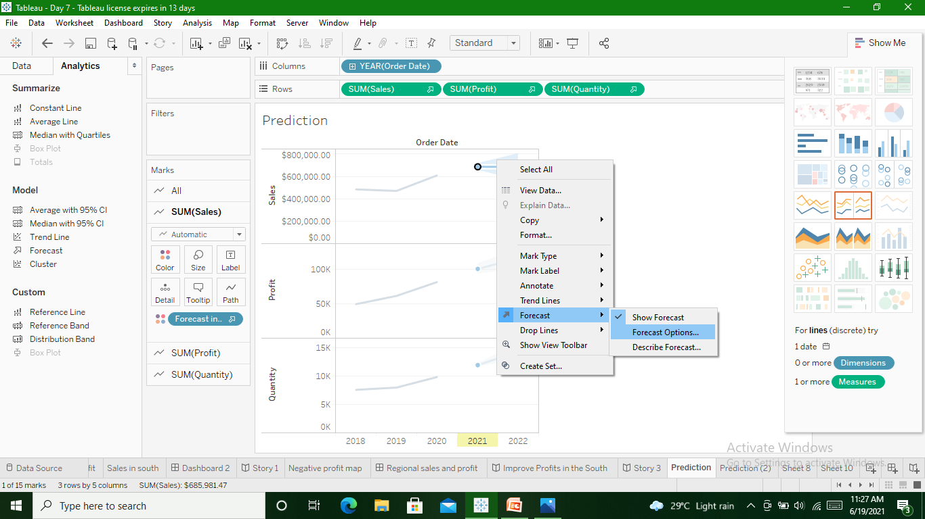
Prediction for next 5 years

Slide 5
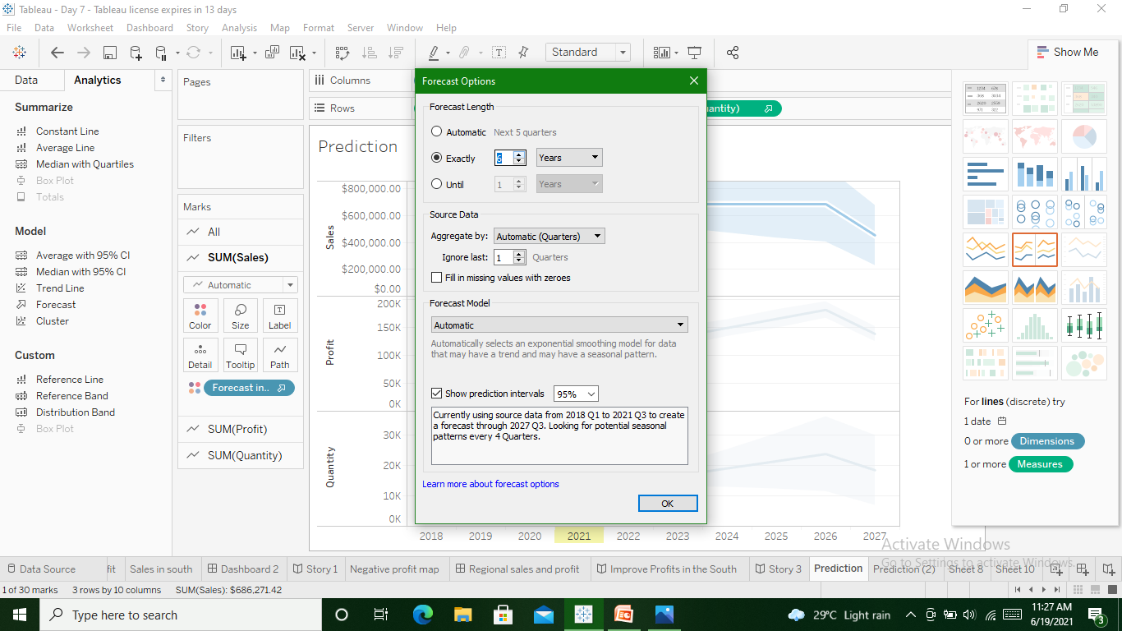
Select ‘exactly’ and change it to 5 years

Slide 6
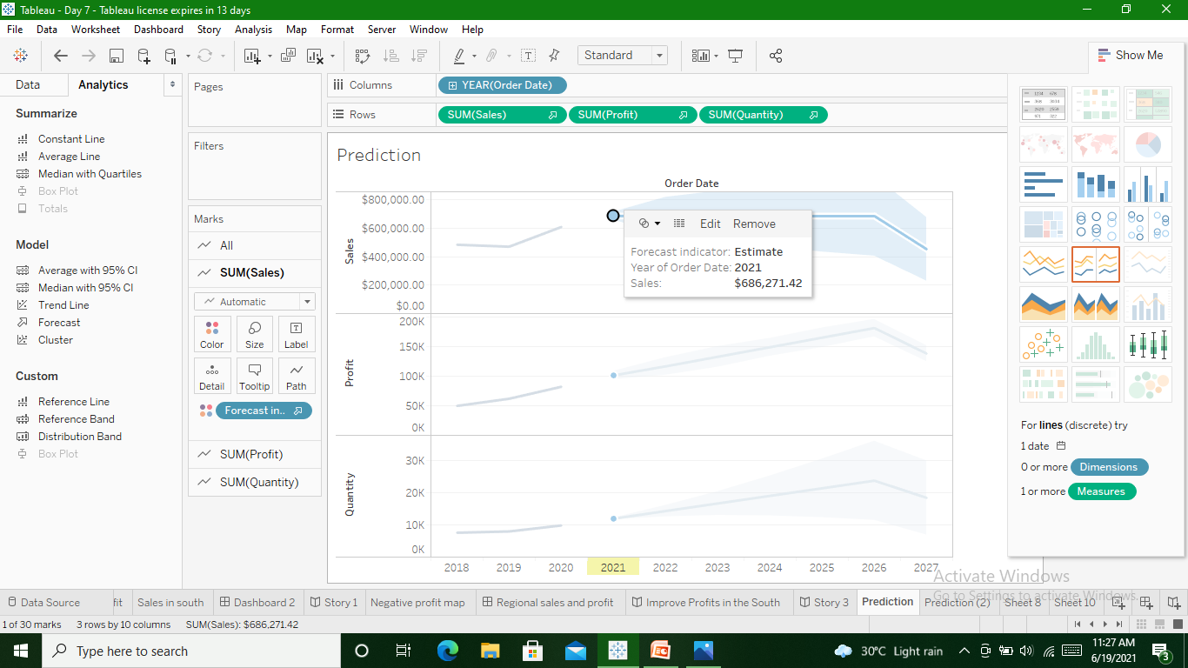
Predicted for 5 years

Slide 7
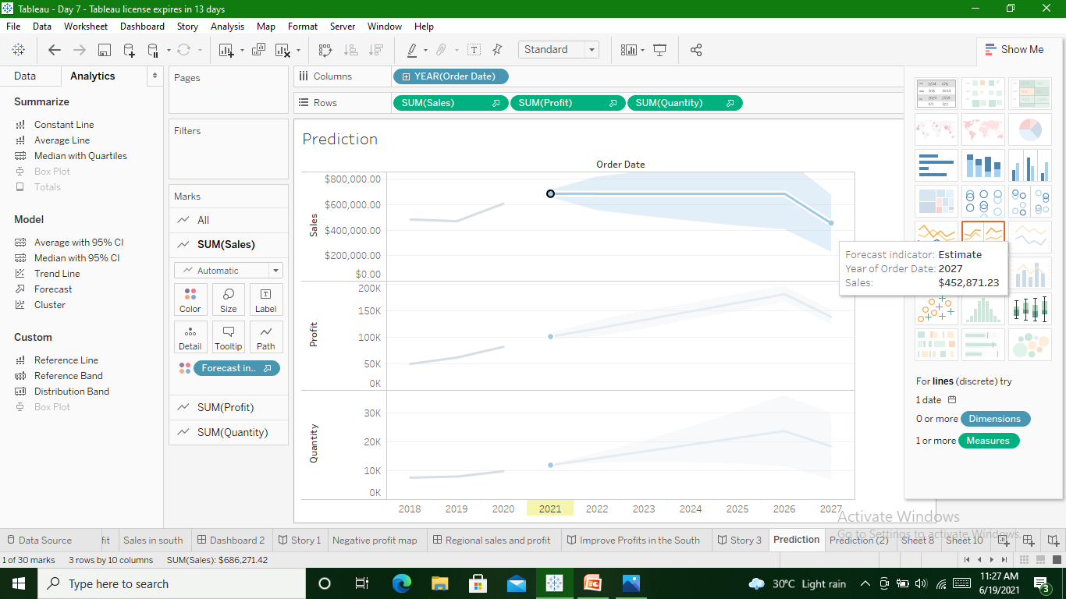
Till 2027

Slide 8
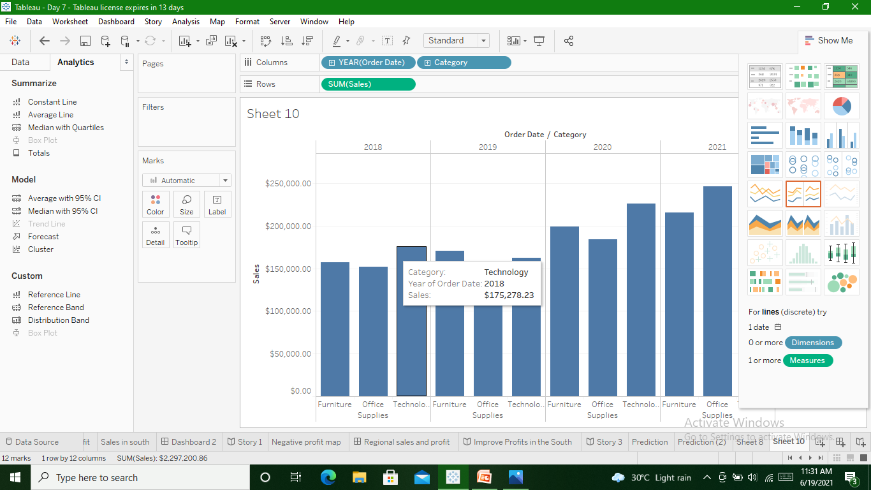
Category Wise Bar Chart for Sales in every year

Slide 9
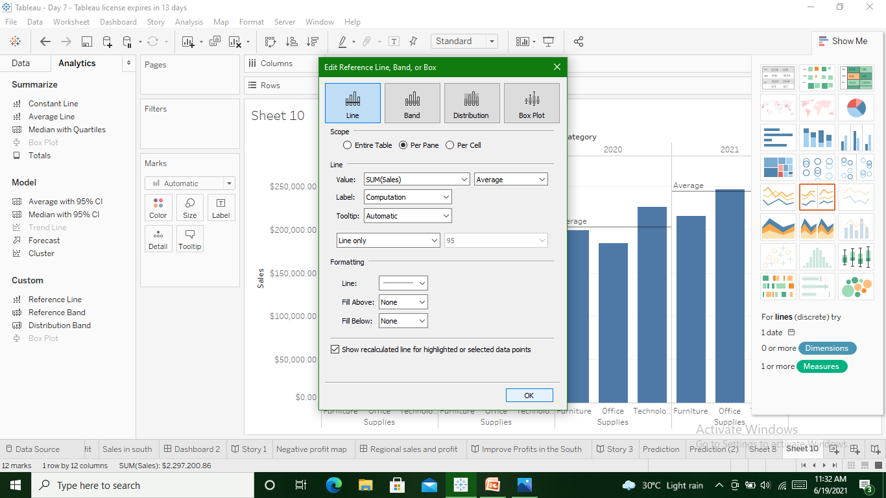
Refernce line to show average

Slide 10
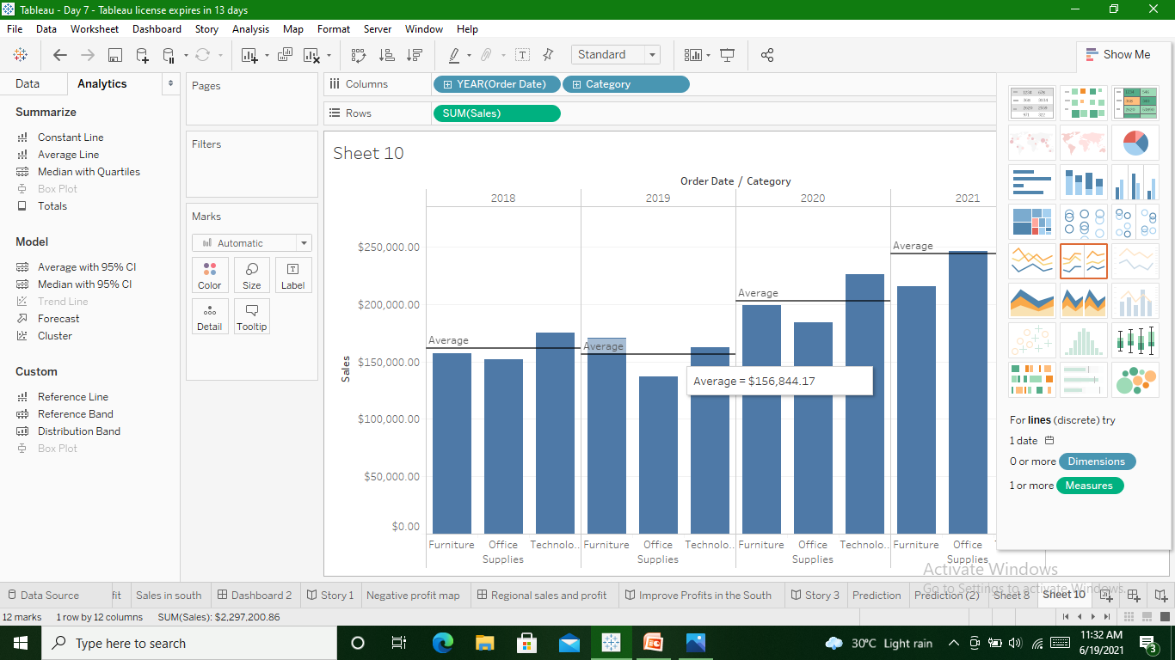

Slide 11
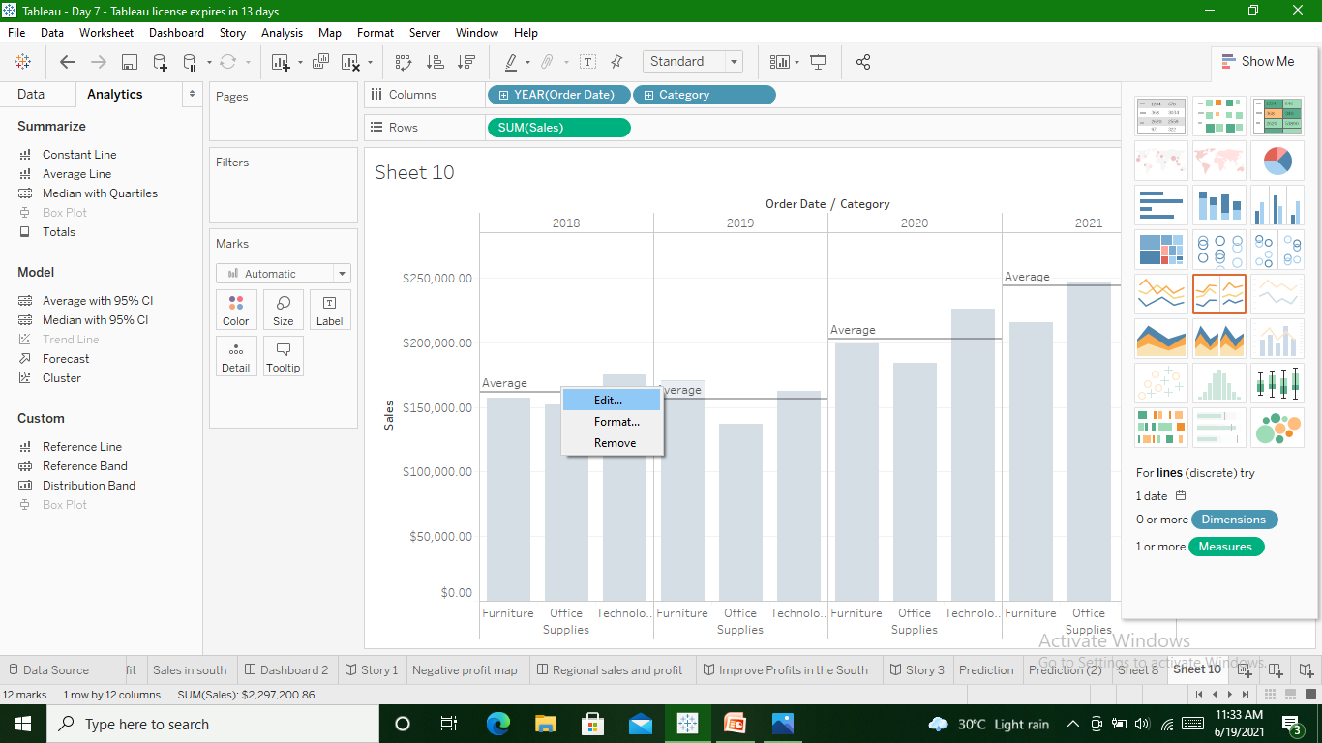
Refernce line to show median

Slide 12
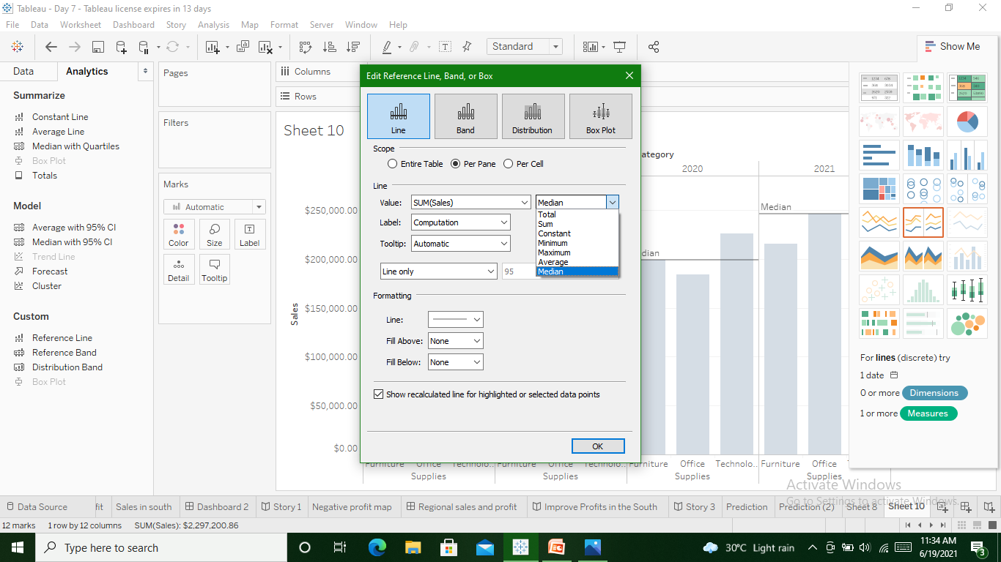

Slide 13


Slide 14
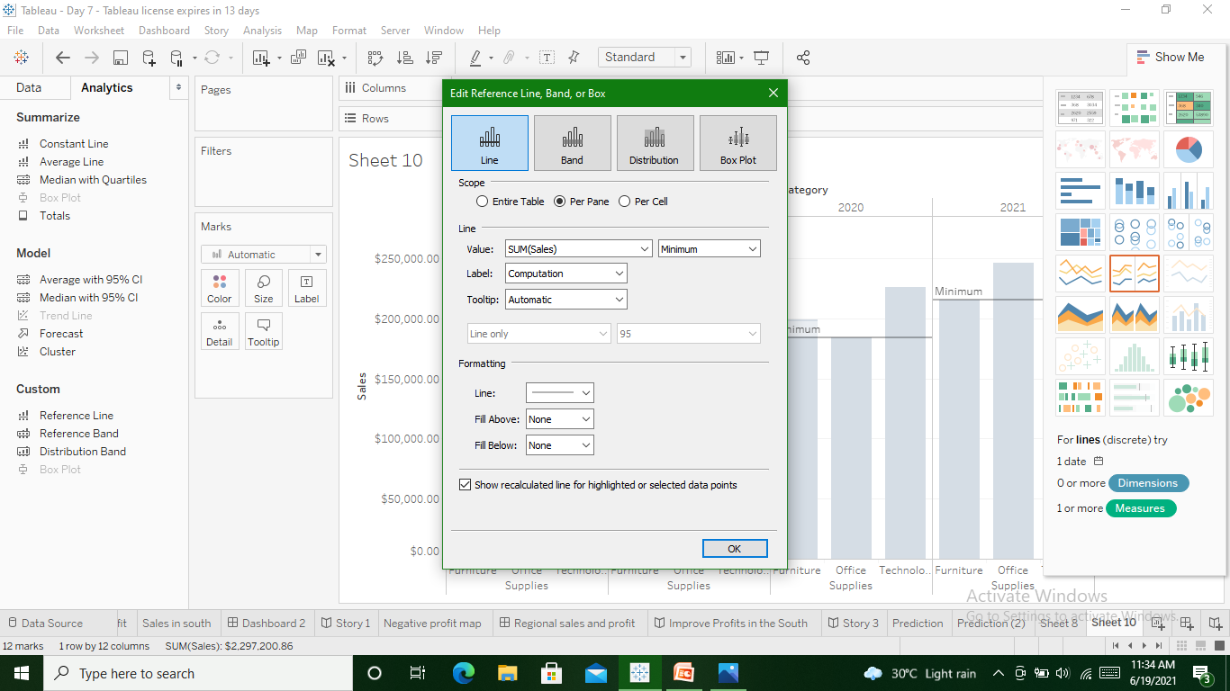
Reference line to show minimum

Slide 15
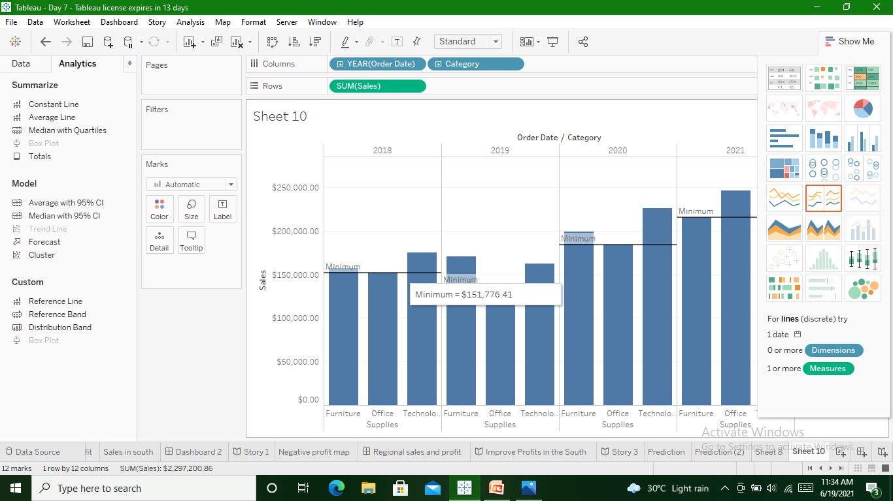

Slide 16
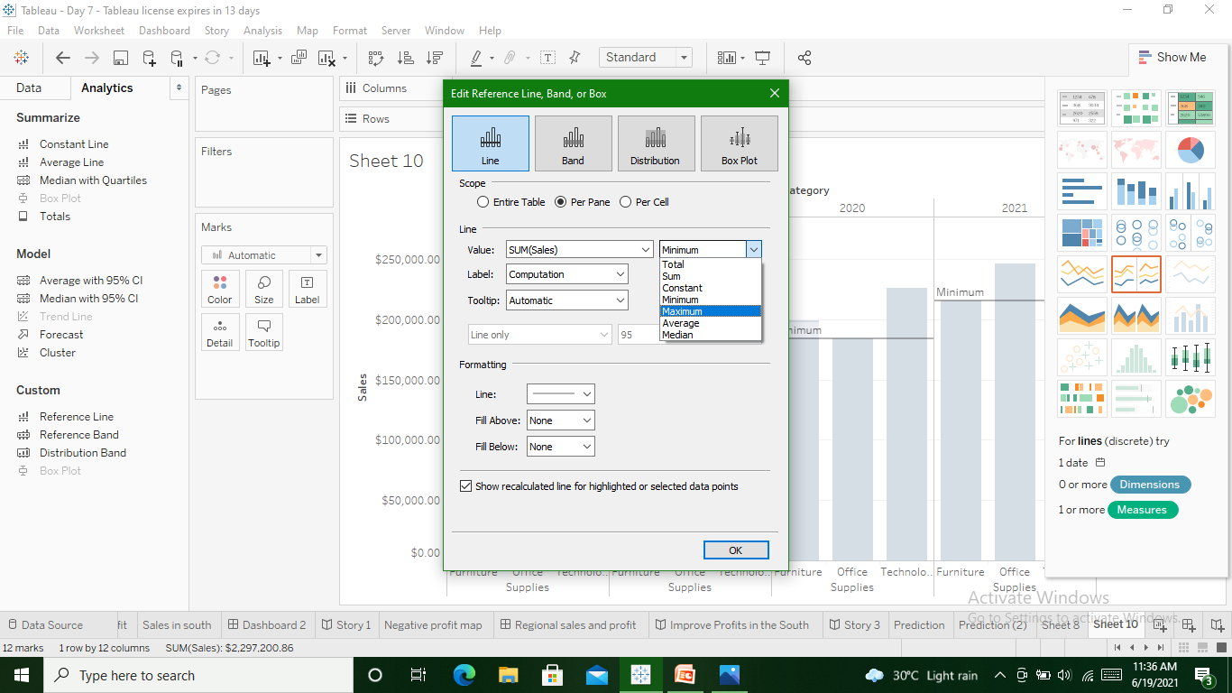
Refernce line to show maximum

Slide 17
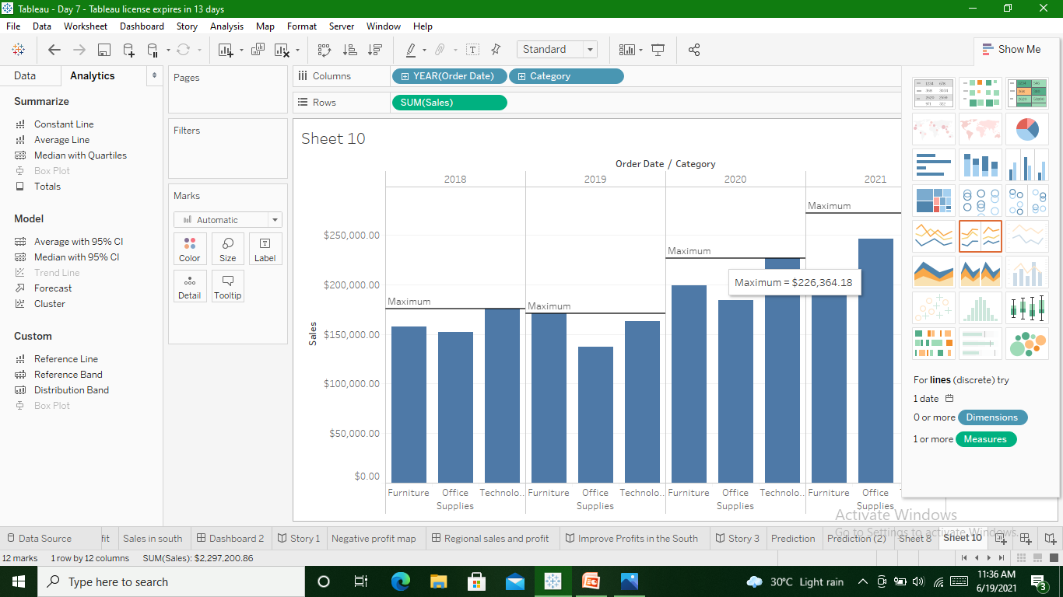

Slide 18
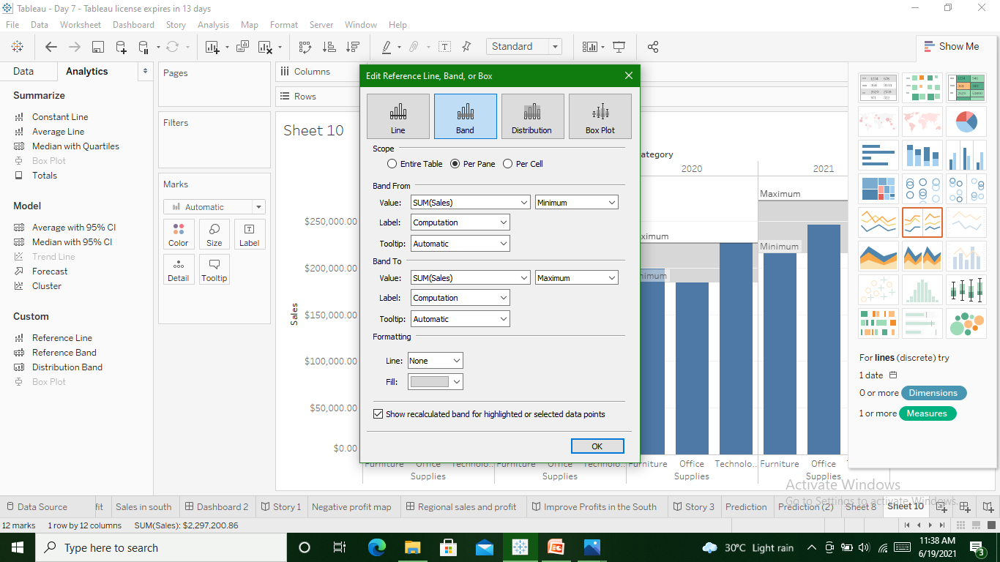
‘Reference band’ for all year

Slide 19
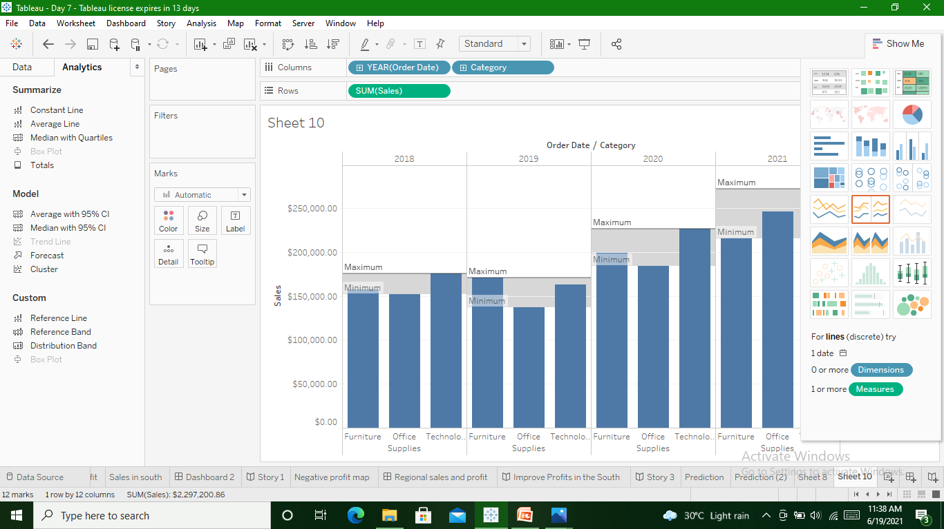

Slide 20
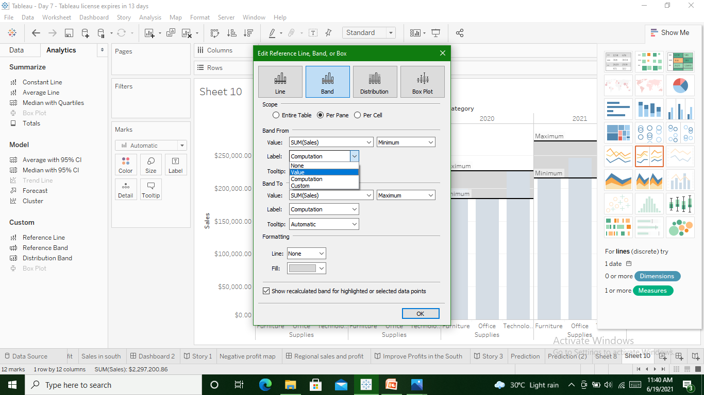
Refernce band value wise

Slide 21


Slide 22
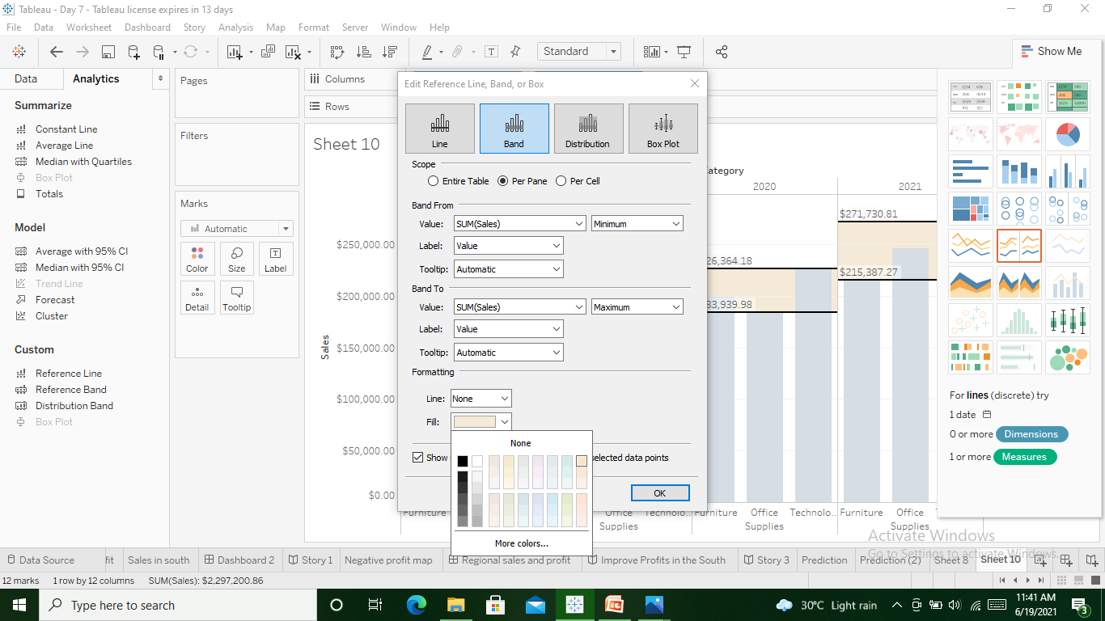
Fill color for band

Slide 23
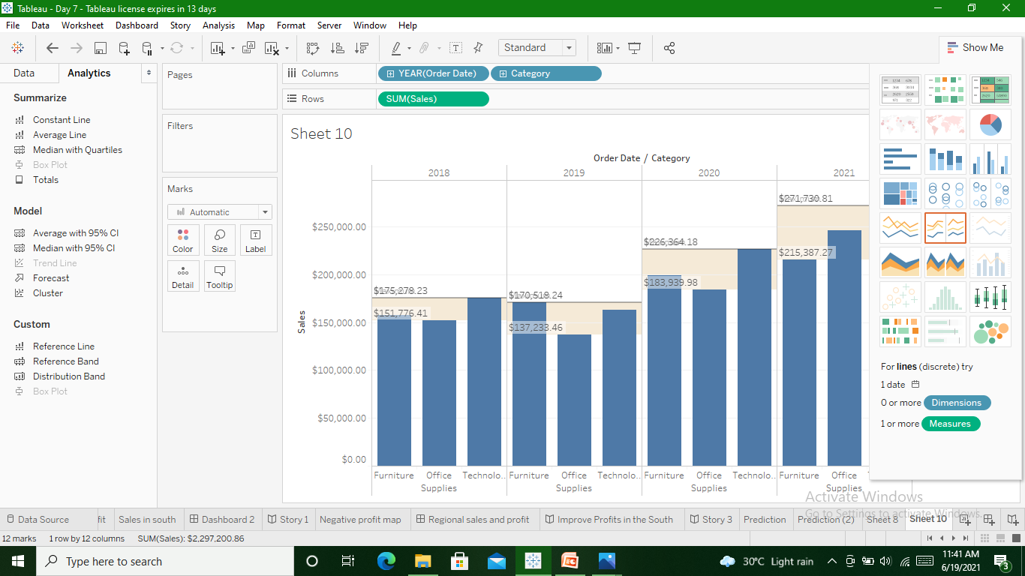

Slide 24
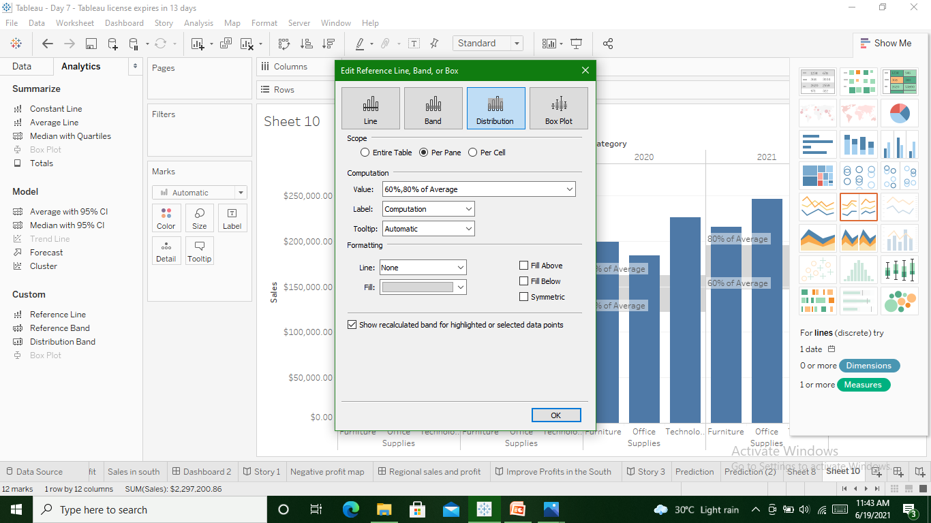
Distribution band to show distrubution & color it

Slide 25
